Slide 1

APPLIED BUSINESS ANALYTICS ON MORBIDITY OF LUNG CANCER
Raiyan Ahmed
Zack Melvin
Rachel Worden

Slide 2
Business Problem
Context:
In today’s world, cancer, and specifically lung cancer, is very serious ongoing an issue and leads to many deaths per year. The American Cancer Society estimates that in 2022, there will be 130,180 deaths from lung cancer with 68,820 being men and 61,360 being women. Lung cancer is the leading cause of cancer deaths in both men and women, making up almost 25% of all cancer deaths
Purpose:
Could we discover any type of relationships between the different socioeconomic variables and the morbidity rate of lung cancer patients?
Data:
The dataset from data.world and it is combination of different census data points (per county) and the morbidity rate due to lung cancer in that county. There are over 30 variables in the dataset.
Audience:
Medical and Research Professionals

Slide 3

Our Questions
Can we create models using the different social, economic, and demographic data points as predictive measures of lung cancer morbidity rates?
If so, which of these socioeconomic variables will have the biggest impact on lung cancer death rate?
Objective:
Finally, can we identify the best predictive model for measures of lung cancer morbidity rates?

Slide 4
Planned Analysis
Methods:
We will use five different data modeling techniques:
Regression
Principal Component
Cluster
Decision Tree
Neural Networks
We will run a simple least-wise fit regression in order to establish a baseline for our models. We will also explore our dataset using cluster analysis, specifically hierarchical, with Ward’s method. We will use Principal Component Analysis (PCA) and hope that it will allow us to reduce the dimensions of our data.
Evaluation:
Summary of Fit - RSquare, RSquare Adj, Root Mean Square Error
Plots and Graphs - Scatter Plots, Distribution Charts, Dendograms, Actual by Predicted Plots
Notes:
Do we need or want to include this?

Slide 5
Data Description
Data Source
Data Size
Input Variables
Output Variable
Data Type
data.world
Before transformation -
34 columns, 3047 rows
After transformation -
32 columns, 2332 rows
avgAnnCount | avgDeathsPerYear | incidenceRate | medIncome | popEst2015 | povertyPercent | studyPerCap | MedianAge | MedianAgeMale | MedianAgeFemale |
AvgHouseholdSize | PercentMarried |
PctNoHS18_24 | PctHS18_24 |
PctSomeCol18_24 | PctBachDeg18_24 |
PctHS25_Over | PctBachDeg25_Over |
PctEmployed16_Over | PctUnemployed16_Over | PctPrivateCoverage |
PctPrivateCoverageAlone | PctEmpPrivCoverage | PctPublicCoverage |
PctPublicCoverageAlone | PctWhite | PctBlack PctAsian | PctOtherRace | PctMarriedHouseholds | BirthRate
deathRate
Continuous

Slide 6
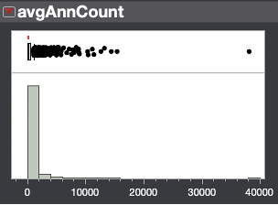
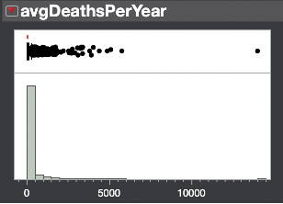
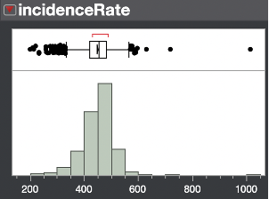
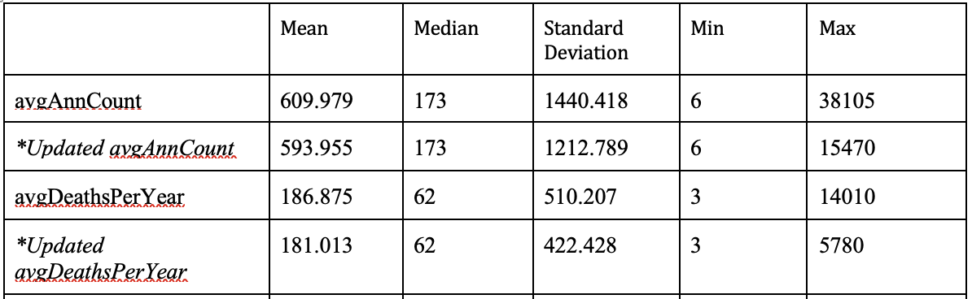
DATA TRANSFORMATION & PREPARATION
Descriptive Analytics
Used to determine outliers
Missing Values
PctSomeCol18_24 - 2,284
PctEmployed16_Over - 151
PctPrivateCoverageAlone - 562
Training/Validation Partition
75% Training
25% Validation

Slide 7
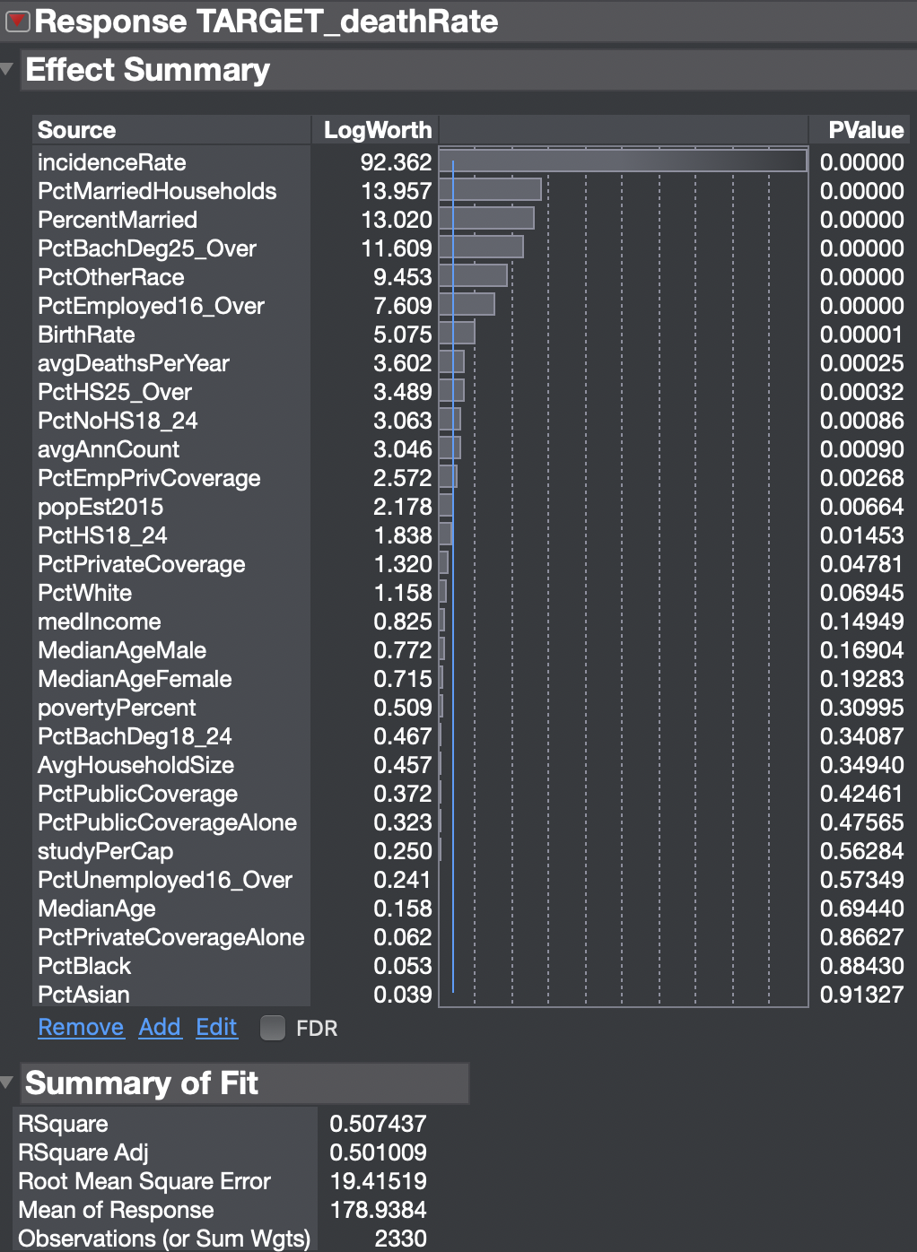
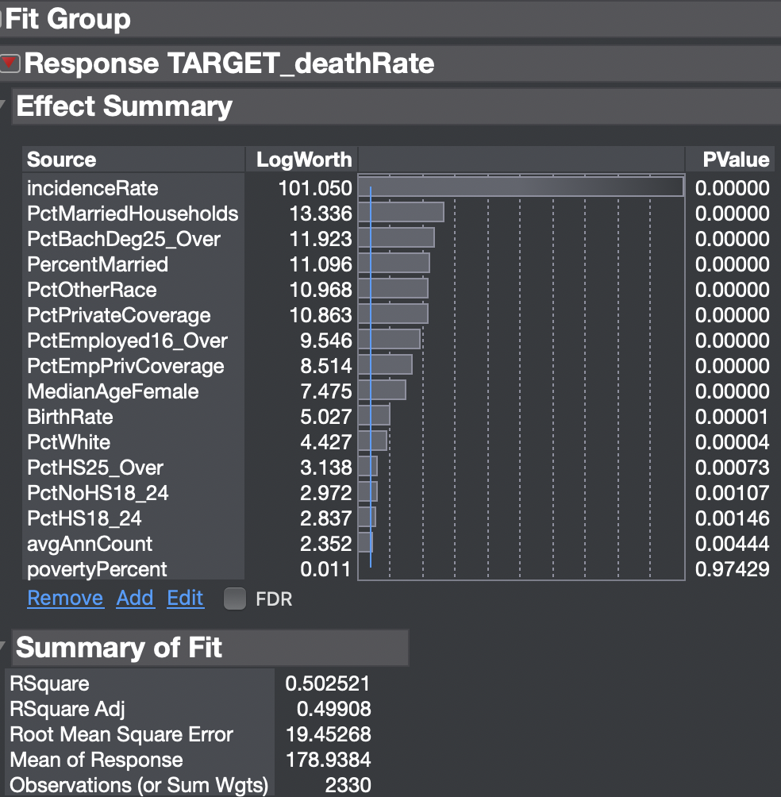
Regression
Initial Model
Final Model
Method -
Simple Least-Wise
# of variables used - 30
~ summary of fit results ~
R2 - 0.507
RMSE - 19.41
Method -
Stepwise
# of variables used - 17
~ summary of fit results ~
R2 - 0.502
RMSE - 19.45

Slide 8
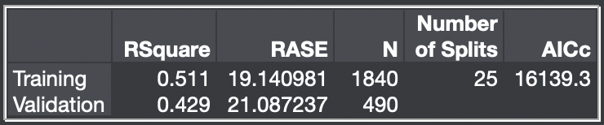
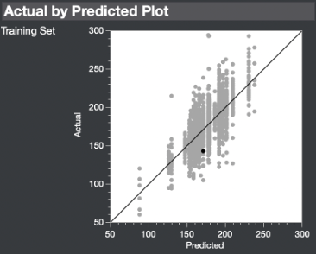
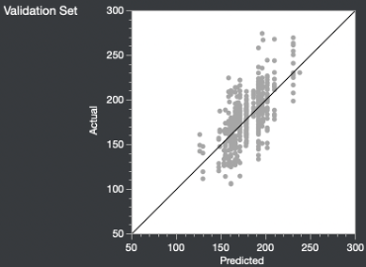
Decision Tree
Method
Summary Report
JMP Partition
Automatic Splitting
Validation portion of 0.2
1840 rows for testing
490 rows for validation
Actual by Predicted
Input Variables
16 variables pulled from stepwise regression results
Target Variable
deathRate

Slide 9
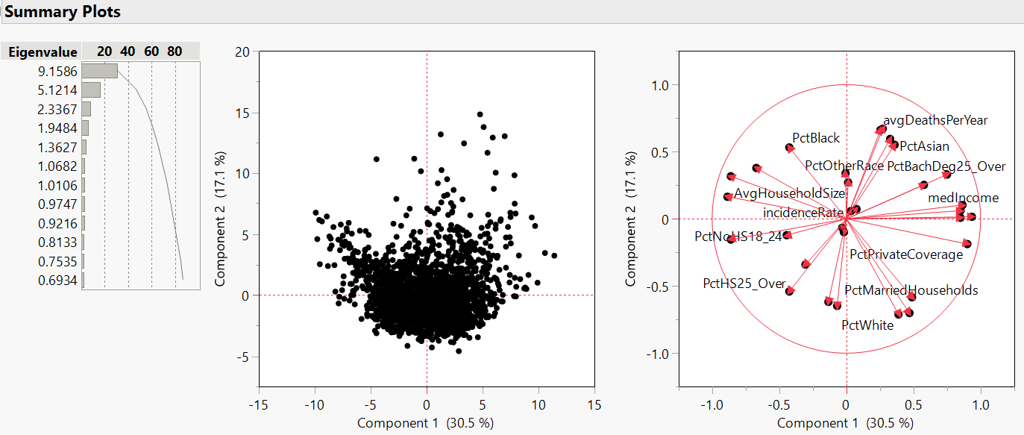
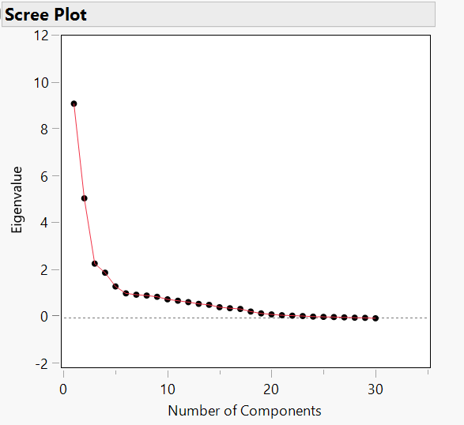
Principal Component Analysis
Use PCA for dimension reduction
  Final dataset has 30 attributes
Target variable of deathRate
Used Scree Plot to determine the need for 3 components based on elbow
  Prin1, Prin2, and Prin 3
These 3 components explain 60% of the variation in the data
F-test has a p-value < 0.0001
Final PCA model:
deathRate=178.94-4.24∙Prin1
Input | R² | RMSE
Original Regression Model | 0.50 | 19.41
Y|Prin1 | 0.22 | 24.30
Y|Prin1, Prin2 | 0.22 | 24.30
Y|Prin1, Prin2, Prin3 | 0.22 | 24.30

Slide 10
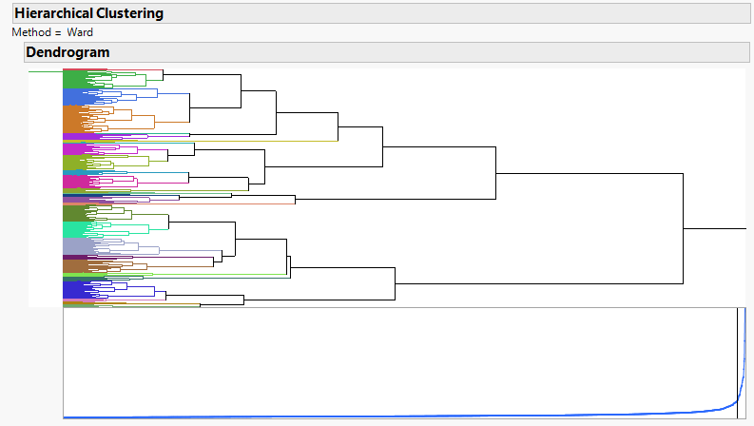
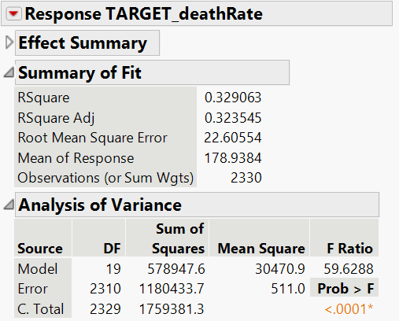
Hierarchical Clustering
Chose hierarchical clustering over k-means clustering due to dataset size
Target variable of deathrate
Generated Dendrogram and Scree Plot
Used Scree Plot to determine optimal number of clusters (20)
  “Elbow” in plot
Results:
  R2 - 0.33
  RMSE - 22.6

Slide 11
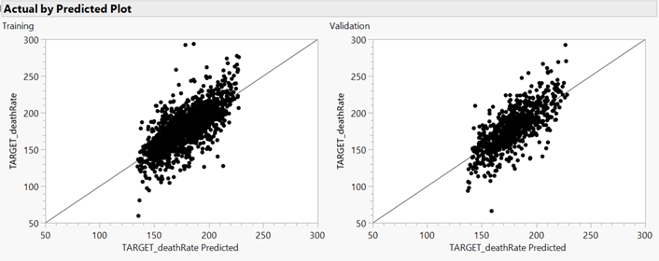
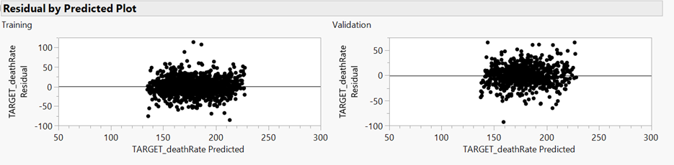
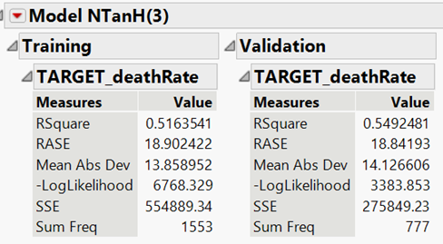
Neural Network
Holdback proportion of 0.333 training/validation split
Target variable of deathRate
Use Actual by Predicted and Residual by Predicted to observe the fit of each split
Results:
  Training:
    R2 - 0.52
    RASE - 18.9
  Validation:
    R2 - 0.55
    RASE - 18.8
Highest performing model

Slide 12
Conclusion
Optimize on Best Results
Areas for Improvement
Neural network yielded highest R2
Should continue prediction exploration using top variables from Stepwise Regression Analysis
  incidentRate, pctMarriedHousehold, pctBachDegree25_Over, PctMarried, PctOtherRace, and PctPrivateCoverage
R2 values range from 0.2 - 0.55
  Further exploration could lead to finding a better model that yields more accurate results

